Slide 1
In This Presentation…..
1.Introduction
2.What Is Li-Fi
3.Its History
4.How Does It Work…..?
5.Real Time Usage Of Li-Fi
6.Li-Fi Over Wi-fi
7.Applications
8.Advantages And Disadvantages
9.Conlusion

Slide 2
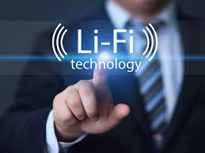
What Is Li-Fi??
1)Li-fi is nothing but…… light fidelity.
2)Li-fi is a wireless optical networking technology
that uses light emitting diode(LED) for data
transmission.
3)It is quite similar to wi-fi but instead it uses visible
light region of electromagnetic spectrum to
transfer data.

Slide 3
Present Scenario
Radio spectrum is congested but the demand for wireless data
gets doubled each year .Everything seems it wants to use
wireless data but the capacity is drying up.
So what can carry this excess demand in the future…..??

Slide 4


It’s History
1)Professor herald haas is widely recognized as the original founder
of Li-Fi.
2)This technology truly began in 1990’s in countries like Germany,Korea and Japan.
3)Harald haas continues to wow the world his potential to use light for communication.

Slide 5

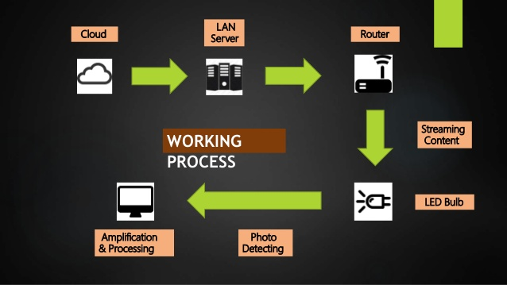
How Does It Work….??
Data from the internet and local networks is used to modulate the intensity of LED light source in a way which is undetectable to the human eye. The photo detector picks up the signal ,which is converted back into a data stream and sent to the mobile or any accessories.

Slide 6
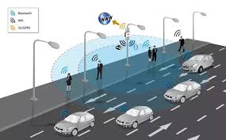
Real Time Usage Of Li-Fi

Slide 7
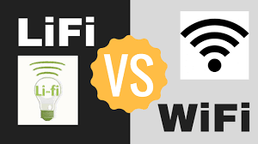
s.no.
1)
2)
3)
4)
5)
6)
Basis of comparison
Wi-Fi
Li-Fi
Security
Not secured(can be hacked)
Secured (cannot be hacked)
Data transmission rate
Slower (uses radio waves)
Much faster (uses visible light)
Range
Traffic control
Where it can be used?
Small
Less (signal becomes
weaker as traffic increases)
Within the range of wi-fi router
Large
More (due to high speed and easy
availability)
Anywhere where the light source is
present)
Cost
Costly
Cheap

Slide 8
Statistics

Slide 9

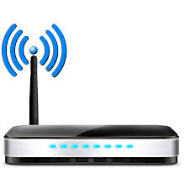


When we use infrared for transmitting , signal transmit in single bit form
1 0 0 1 1 0 1 0 1 1 1 1 0 1 0 0 1 1 1 0 0 1
When we use Li-fi for transmitting signal,
tons of data transmits in a second

Slide 10



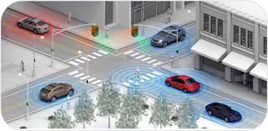
Some Applications
Smart lightning can create li fi
hotspot means low cost And high
speed data Transmission.
Under water
We cannot use radio waves
underwater but can use li-fi.
At flight there is a bulb over
each passenger seat. So, here we can give them high speed internet connectivity.
There is LED light in the head or
tail light in vehicle and with the
help of Li-fi, vehicle can communicate
with each other and can reduce accidents.

Slide 11
Advantages and disadvantages
Advantages
Li-fi can solve problems related to the insufficiency of radio frequency bandwidth because this technology uses
visible spectrum.
High data transmission rates of up to 10Gbps can be achieved.
Since light cannot penetrate walls, it provides privacy and security that wi-fi cannot.
Disadvantages
These signals cannot penetrate walls. So we need wired bulb in the other room as well.
It only works if there is direct line of sight between source and receiver.
It interferences from external sources like sunlight ,normal bulbs, opaque materials which interrupts the
communication.

Slide 12

Conclusion….
If this technology can be put into practical use , every
bulb can be used something like a Wi-fi hotspot to
transmit wireless data and we will proceed towards
the cleaner, safer and a brighter future.

Slide 13


The
End
Presented by ……….Nischal

